Slide 1
Employee Data Analysis using Excel
STUDENT NAME:S.Vyshnavi
REGISTER NO: 312219639 (asunm1715cc1221715048)
DEPARTMENT:B.com(G)
COLLEGE: Thalapathy k.vinayakam women art' science college

Slide 2
PROJECT TITLE
Employee Performance Analysis using Excel
Excal can be used to analyse employee performance by tracking matrix like productivity, Attendance, quality of work.

Slide 3


AGENDA
Problem Statement
Project Overview
End Users
Our Solution and Proposition
Dataset Description
Modelling Approach
Results and Discussion
Conclusion
3/21/2024 Annual Review

Slide 4

PROBLEM STATEMENT
QUALITY OF WORK.
Utilitze perfomance reviews
WORK EFFICIENCY
Select an output and unit of time
to measure.

Slide 5

PROJECT OVERVIEW
.
The project where you if a document that provide the comprehensive summary of your project including it's a goals time lane resources and potential useful tools for communicating the project purpose and approach to team members and Star gold and can be used as a reference chowk the project 's life cycle.

Slide 6

WHO ARE THE END USERS?
In uses of employee data analysis using Excel include employees and companies:
*Employees: can use my analytics about their own product activities such as how how much time they spend in meetingworkings versus .
*Managers: can use workplace analytics to view appreciated results for my analytics to evaluate team productivity managers can use this information to set up new process to improve productivity.
*Companies: can you workplace analytics to view and evil with team productivity.
The end users of employee data analysis. Using

Slide 7

OUR SOLUTION AND ITS VALUE PROPOSITION
Condition formating -
missing
Filter -remove
Formula -performance
Pivot-summary
Graphdata visualization.

Slide 8
Dataset Description
Salesman: Target: total sales: Target HTI: Away from
Umesh. 500. 344. 68.80%. 31.20%.
Gita. 500. 455. 91.00%. 9.00%.
Ram. 500. 345. 69.00%. 31.00%.

Slide 9

THE "WOW" IN OUR SOLUTION
Perfomance level-IFC(28-5,"VERY HIGH" 28
-4,"HIGH" 28-3,"MED", TRUE,"LOW")
3/21/2024 Annual Review
9

Slide 10
MODELLING
1) data collection?
*Set up a dedicated for inputting raw data.*Data used.*data collection
2) data planning?
*Create a new column for the cleaned copy the cleaned data and paste it.
*As well as to remove the formulas.
3) features collection?
*Missing value identity.
*Missing value filter out.
4) Valuation?
*To perform the task outlined in assignment using Excel
10

Slide 11
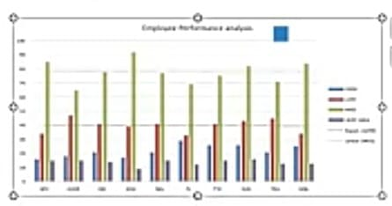
RESULTS
11

Slide 12
conclusion
Existing Employee performance analysis systems come to a conclusion post observing the performance of the employee.
The recruitments of new employees are manually done by
assessing the candidate on his/her various skills.

